Slide 1

Lecture 2: Classes, interfaces, variable length parameters & generics
WRPV301: Advanced Programming
Dr Simone Beets
Notes:
Ever need to zoom in on intellij: alt + shift + = (in) / alt + shift + - (out)
Win + P for changing screen display settings

Slide 2

Class exercise

Slide 3

Class exercise
You have 10 minutes…
Instructions:
In groups of 5 (add your names)
You can use any device that you have on you but also don’t forget about chatting to each other too!
You can use any source available
Illustrate your answers using examples using pen & paper & hand in
Questions:
What is the difference between an abstract class & an interface?
When is it more appropriate to use an abstract class over an interface?
When is it more appropriate to use an interface over an abstract class?
What tools did you use to find your answers to the above questions?
Did the tools in (4) help your understanding or hinder it? How?

Slide 4

Access modifiers

Slide 5

What is an example of an access modifier?
Notes:
Public, protected, private

Slide 6
Access modifiers
public
Accessible from anywhere
Interface methods are public by default
protected
Accessible from within package & sub-classes (not necessarily in same package)
i.e., a different class in same package may access a protected field/method, but generally should not

Slide 7
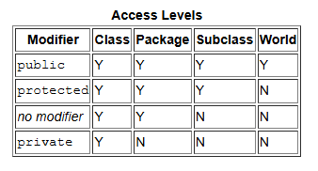
Access modifiers
private
Only accessible from within the class
No explicit modifier (e.g., void myMethod())
package-private – default access modifier
Accessible from within the same package
Use most restrictive as possible – unless have a very good reason
http://docs.oracle.com/javase/tutorial/java/javaOO/accesscontrol.html
Why?
Notes:
Package-private
More restrictive than public (preventing access from other packages)
Less restrictive than private (allows access to other classes in the same package)
Good for when you want to keep implementation details hidden, but still allow access within a group of related classes
“World” means accessible from anywhere → public (no other), so within the same package & from different packages
Why most restrictive as possible?
(encapsulation & data hiding – keeping fields & methods private, minimising dependency – reducing coupling, improved maintainability – change without affecting other parts of system, better control – not affected by outside code, prevention of unintended usage – misuse methods, security – less accessible so harder to exploit (see next slide)

Slide 8
Why?
Encapsulation & data hiding
Minimising dependencies
Improved maintainability
Better control over API design
Prevention of unintended usage
Security
Notes:
Why?
Encapsulation & data hiding
Keeping methods/fields private means that how a class works (its internal workings) are hidden from outside code
Minimises bugs or unintentional changes
Minimising dependencies
A class will only depend on what is provided by the other class
Coupling is minimised & easier to maintain code
Improved maintainability
Code of a private method/field can be changed without affecting other sections of code
All public, then possibly all interlinked
Better control over API design
Difficult to change code in the future if external code relies on it
Gives control on how the class is used by restricting access
Prevention of unintended usage
Methods can be used in a way that was not intended if they shouldn’t be accessible but they are
Good usage patterns if private/package-private
Security
Harder to exploit/misuse code that is not or is less accessible
Changes then can’t be made that makes your code more vulnerable to security issues.
What is a good reason to not have it as restricted?
When making method or field accessible to other parts of the application because they need to be
Overriding a method in a subclass must override a method (use protected)
For code to interact across packages but you don’t need full exposure (package-private / controlled public access with proper encapsulation)

Slide 9
Other (non-access) modifiers
static
May access a field/method via the class
Does not require an object instance
Fields/methods shared by all instances of class
Static inner class (see later) may be instantiated without the outer class
http://docs.oracle.com/javase/tutorial/java/javaOO/classvars.html

Slide 10
Other (non-access) modifiers
final
May not be changed once initialized
a final class may not be extended
a final field initialised once & cannot be changed
a final method may not be overridden
http://docs.oracle.com/javase/tutorial/java/IandI/final.html
See /example01
native, staticfp, synchronized, transient & volatile
Read up if interested
Notes:
Anyone take a guess on what transient means?
Should not be serialised when the object is converted to a byte stream (when saving an object to a file / sending over a network)
Field won’t be saved when object serialised
When object deserialised, field will have a default value (null for objects, 0 for numbers, false for Boolean)
Example, useful for passwords (sensitive information) that should not be stored/transmitted in serialised form
Example, excluding large objects from serialisation (such as cache) if they can be constructed again somehow

Slide 11
Types of classes
Named (“normal”)
Must be public if want to instantiate elsewhere using new
Abstract
May not instantiate this class
Serves as a base class to be used for inheritance, typically used for polymorphism
http://docs.oracle.com/javase/tutorial/java/IandI/abstract.html

Slide 12
Types of classes
Inner
Defined inside another class (outer class)
May access outer class fields and methods
Cannot exist by itself (unless defined as static)
Visibility modifier of inner class determines who may “see” it
Static Inner
Static inner classes may be instantiated without an instantiation of the outer class
See /example02

Slide 13
Types of classes
Local/Anonymous Inner Classes
Class defined inside another class’s method
Local class (also known as “named class”) & has a class name
Can instantiate multiple instances
Anonymous class defined inline & has no name
Declares & instantiates a class at the same time
Often used in UIs for responding to UI events
See /example03
http://docs.oracle.com/javase/tutorial/java/javaOO/localclasses.html

Slide 14
Some differences between class types & interfaces
 | Interface | “Regular” Named | Abstract | Inner | Static Inner | Anonymous
Can be instantiated | N | Y | N | Only from within outer class | Y | Y
Can have multiple instances | Y | Y | Y | Y | Y | N
Can have fields | Only constants | Y | Y | Y | Y | Y
Has method bodies | Only default, typically none | All methods implemented | Can have abstract or implemented methods | All implemented | All implemented | All implemented
Can be extended/ implemented | Y | Y | Y | Y | Y | N
Notes:
Why would we use anonymous classes?
To create a single-use subclass/implementation without needing to define a separate class
i.e., only use once where a full named implementation is not needed

Slide 15
When to use each one?
Abstract class
Interface
Inner classes
Static inner class
Anonymous class
Abstract class?
Acts as root of an inheritance tree
Provides fields & possibly partial implementation
Typically for large groups of related data & behaviour

Slide 16
When to use each one?
Abstract class
Interface
Inner classes
Static inner class
Anonymous class
Interface?
Typically for small groups of related behaviour
Can allow multiple classes from different parts of an inheritance tree to be used polymorphically

Slide 17
When to use each one?
Abstract class
Interface
Inner classes
Static inner class
Anonymous class
Inner class?
Classes that do not make sense, or are not valid, outside the context of the outer class
Is not reusable in different context

Slide 18
When to use each one?
Abstract class
Interface
Inner classes
Static inner class
Anonymous class
Static inner class?
Want to have a “nested” relationship, but allow inner class to be able to exist without the outer class

Slide 19
When to use each one?
Abstract class
Interface
Inner classes
Static inner class
Anonymous class
Anonymous class?
Want to create a typically small object, but an entire named definition not required
Extension is not of importance, simply an implementation
Notes:
Cat → animal example

Slide 20
Ways of defining & instantiating classes
Use the new keyword to instantiate a named class
Use the clone() method (if implemented)
Depending on class, a shallow or deep copy of an existing object can be made
Need to promote from protected to public if it is to be used by other objects
Typically, a copy constructor is preferred
See /example04
In-line creation of an anonymous class (also uses new)
Previous example

Slide 21

Variable length parameters

Slide 22
Variable length parameters
Sometimes want to accept a different number of variable parameters
E.g., sum of integers (but not passed an array)
Indicated as <type>… <parameter name>, e.g., sum(int… n)
accessed inside method as if was an array
Each method may only have:
one parameter of variable length
else how would now where one ends & next starts?
the variable length parameter must be last one
e.g., f(int…n, int count) is not allowed
See /example05

Slide 23

Generics

Slide 24
Generics
defn. (general):
typical, not unique or specific
defn. (computer science):
code/methods that can work with any type of data
“A generic function can handle different data types.”
“The movie’s plot was generic.”
Notes:
Generic: means general, not specific or widely applicable
Go to pharmacy and ask for a generic, that means you’re asking for the generic of the specific medicine (not branded)…

Slide 25
How are generics useful to us?
Convenient way of allowing classes to be used as “templates” where specific field, parameter & return types can be specified
Allows the amount of casting to be reduced
Notes:
Convenient way of allowing classes to be used as “templates” where specific field, parameter & return types can be specified
Allows the amount of casting to be reduced

Slide 26
Using Generic Classes <T>
(Often) where:
the same “code” is used for multiple implementations &
the only difference are the types of fields, parameters or returned values
Why?
Provides type-safe checking at compile-time
Allows a class or interface to be parameterised with type information
See /example01

Slide 27
Non-generic
Using generics
// Stack can hold any object
Stack s = new Stack();
s.push(“hello”);
String t = (String) s.pop();
s.push(10);
t = (String) s.pop();
// Casting error,
// only found at run-time
// Stack can only hold strings
Stack<String> s = new Stack<>();
s.push(“hello”);
// Note cast not required anymore
String t = s.pop();
s.push(10);
// Won’t be allowed to push
// at compile time
http://docs.oracle.com/javase/tutorial/java/generics/

Slide 28
Why should we rather find errors at compile time instead of at run time?

Slide 29
Early detection
Safer code
Lower cost to fix
Better optimisation
Confidence to refactor
Errors at compile time
Notes:
Why?
Early detection:
Find mistakes before the program runs → saves time & effort
Safer code:
Hopefully not many surprises when you are running your program (imagine you have an uncaught exception when someone is trying to do their banking?)
Lower cost to fix:
Find bugs while still developing features will end up being much cheaper than after going to production
Better optimisation:
Can make your code better & cater for some possibly forgotten/not thought about cases upfront
Confidence to refactor:
Safer to make changes & improve the code if you need to later on

Slide 30
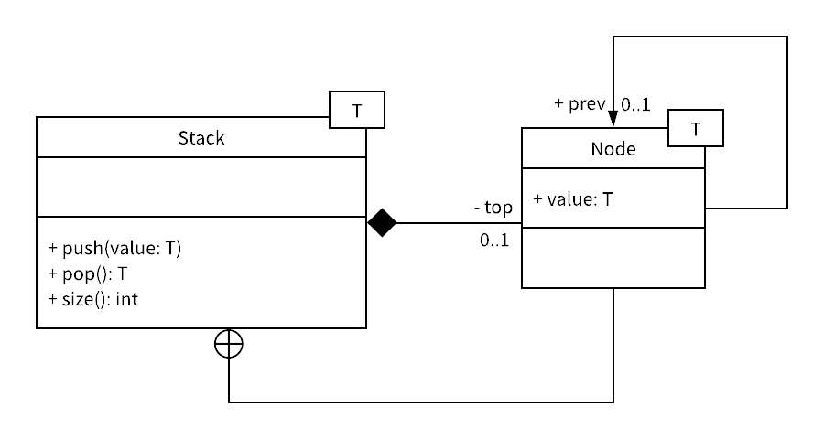
Generics UML Notation
T
T
https://www.visual-paradigm.com/guide/uml-unified-modeling-language/uml-aggregation-vs-composition/
Notes:
Class diagram for a generic Stack implementation:
Both the Stack & the Node can store any type of data (because of the generics)
Components:
Generics (<T>):
<T> → type parameter
T can be any type (Integer, String, Person, etc.)
E.g. Stack<Integer>, Stack<Person>
Classes:
Stack <T>: generic stack that works with type T
Methods:
push → adds value of type T
pop → removes & returns value of type T
size → returns number of items in the stack
Node <T>: single node that stores a value of type T
Attribute: Public attribute of type T
Relationships:
Solid line with diamond (composition):
Stack<T> is made up of Node<T> instances
Strong ownership (so when the stack is destroyed, so are the nodes)
Why is Node pointing back to itself?
Self-association: Each Node can reference another Node of the same type (e.g., linked lists)

Slide 31
Using Generic Classes <T> (continued…)
May use “the diamond” if at compile-time, the types can be inferred for a constructor (language level will need to be set to 7+), e.g.
Unary<Integer> integerUnit = new Unary<>();
Can use multiple types, e.g.
public class Triple<T,U,V> {…}
Can specify that only types descending/implementing a specific class/interface may be used (bounded parameter types), e.g.
public class Example<T extends SomeClass> {…}
public class Example<T extends SomeInterface> {…}
public class Example<T extends A & B & C> {…}
note if any are a class, must be 1st

Slide 32
Using Generic Classes <T> (continued…)
public class Example<T extends A & B & C> {…}
Useful when expect some base behaviour of the type
May use parameterised types as types as well, e.g.
Pair<String, Unary<Integer>> p = new Pair<>("primes", new Unary<Integer>(...));

Slide 33
Using Generic Methods <T>
Sometimes, we would like to use different parameter or return types for a specific method
Limited to the scope of the method, not the entire class
See /example02
public class Utils {
:
public <K,V> String toString(Pair<K,V> pair) {
K key = pair.getKey();
V value = pair.getValue();
String s = “”;
: do something with s, key & value
return s;
}
}

Slide 34
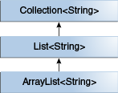
Using Generics <T> with inheritance
You have a method call myMethod(Unary<Object> unary)
Although Integer extends Number, which extends Object…
myMethod(Unary<Number> unary)& myMethod(Unary<Integer> unary) are not acceptable
Unary<Number> & Unary<Integer> do not descend from Unary<Object>
It is possible to extend classes, e.g.
ArrayList<String> can extend List<String>, which can extend Collection<String>
Read http://docs.oracle.com/javase/tutorial/java/generics/inheritance.html
Notes:
Unary<Number> & Unary<Integer> are not subtypes of Unary<Object>

Slide 35
Generics <?> wildcards
IF the type is not important, i.e., you don’t have any specific fields of the type & you are only interested whether extends a class/interface – upper bounded wildcard
Can also use a lower bounded wildcard – not used often though, e.g.
void someMethod(<? super SomeClass> param)
Read http://docs.oracle.com/javase/tutorial/java/generics/restrictions.html for some restrictions on generics
void someMethod(<? extends SomeClass> param) {
SomeClass p = (SomeClass) param;
: do something with p
}
Notes:
Unary<Number> & Unary<Integer> are not subtypes of Unary<Object>

Slide 36

Assignment 1
Do not forget about it
Due next week (check the schedule)
After submitted, you’ll be assigned peer reviews due by the Friday of that week

